Slide 1
Predicting Loan Applicant Risk Profile Using Machine Learning
Commerce 3FN3 Big Data in Finance
G-15

Slide 2
Table of Contents
Problem Description
Problem Description
Current Applications
Solution Framing
Solution Summary
Conceptual Overview
Major Results
Potential Savings
Tools Used
Implementation Timeline
Solution Details
Assumptions
Data Gathering and Import
Data Cleanup and Normalization
Machine Learning Setup
Machine Learning Algorithms
Deep Learning
Results and Recommendations
Accuracy Results
Recommendations
Business Impacts
Next Steps and Timeline
Summary

Slide 3
Problem Description
Commerce 3FN3 Big Data in Finance
G-15

Slide 4
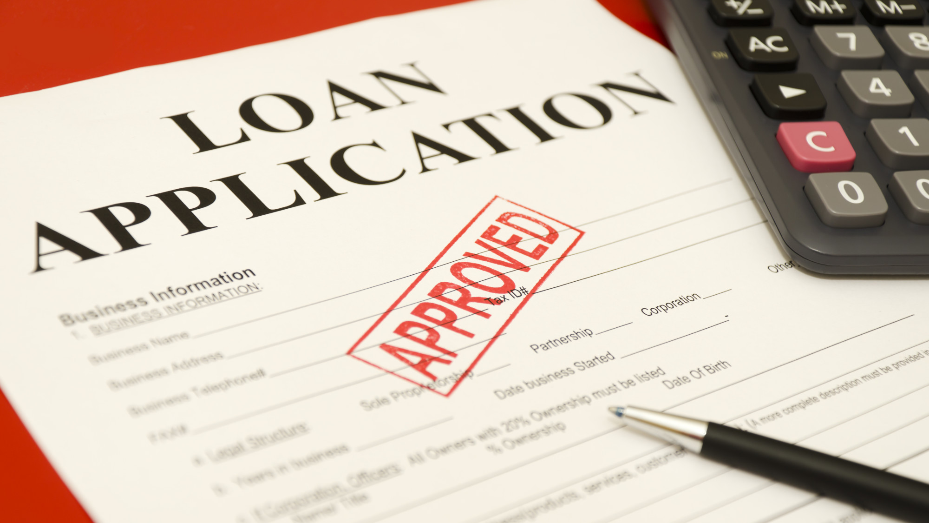
Problem Background
Every year banks receive thousands of loan applications each with unique circumstances that must be evaluated. This presents a variety of issues for banks to solve such as time consumption, inconsistencies, limited scalability, underutilization of data, and compliance risks. The first and most prominent issue, is how much time must be allocated to evaluating loan applications by employees of the firm. Traditionally, financial institutions have used teams of people to evaluate each applicant’s information, and this is both expensive and time consuming. Human workers also make mistakes. During each evaluation process, errors can be made, and this can lead to unfair outcomes for loan applicants or increased risk for the institution. Another disadvantage of relying only on employees to process loan applications is that the demand for loans is not linear. When a surge of loan requests come in, having a limited team can cause bottlenecks in the workflow leading to delays. Generally, depending on the amount and complexity of the loan request, institutions are flooded with vast amounts of data about each candidate. Without the support of software and machine learning, interacting with all the information about each loan applicant is impossible for even a large team of employees. Finally, manual systems for evaluating loan applications may lack transparency and fairness in lending decisions. Regulations require institutions to carefully follow a set a guideline for fairness and transparency, and human employees working with manual systems may struggle to document and justify decisions, exposing institutions to compliance risks. Clearly, a digital solution is required.

Slide 5




Current Applications
Banks such as Deutsche Bank, Bank of America, and JP Morgan Chase are on the right track. These banks are adopting machine learning and robotic process automation to improve their loan processing systems and address the plethora of issues. Some examples of software platforms that can streamline the loan processing workflow are nCino, LendingPad, Finastra, and Fiserv. nCino is a cloud-based platform that automates application intake, loan origination, underwriting, and compliance tracking. LendingPad is designed for mortgage lenders, and it offers tools for document management and risk assessment. Finastra and Finserv are major players in the financial software space, and they offer solutions for loan lifecycle management, with advanced analytics and machine learning that optimizes decision making.

Slide 6

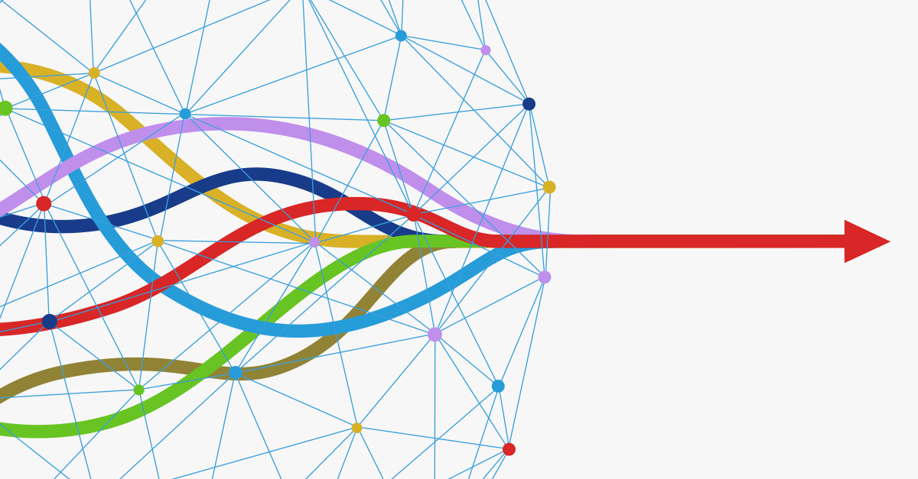
Solution Framing
The next step for a definite solution to automating banks loans is combining the features of the existing systems into a streamlined and accurate program. This is what we hope to accomplish with our project. Our code will analyze large sets of data and will be supervised learning built off risk profiles. This project will provide an accurate, transparent, and simple system that highlights the risk of each loan applicant to assist institutions of all sizes in the decision-making process.

Slide 7
Solution Summary
Commerce 3FN3 Big Data in Finance
G-15

Slide 8

Conceptual Overview
The solution takes a large dataset in the form of client financial profiles, cleans the data and then trains a machine learning algorithm. The algorithm can then predict a new applicant’s risk profile and determine if they should be approved for a loan or not.

Slide 9

Results and Output of the Solution
The algorithm itself, given client metrics, will evaluate the applicant based on previous loan applications from other clients and their outcomes. This evaluation will determine if the client is likely or unlikely to successfully pay off the loan and subsequently if they should be approved or declined for the loan.

Slide 10

Potential Savings and Improvements
The solution has broad implications for the financial sector. Since loan applications are not spaced out linearly, a backlog of applications can often exist leading to overworked staff who are prone to making mistakes in the approval or denial of loan applications. This solution can be scaled very easily to meet the demand at a given time by utilizing more compute power which can otherwise be held in reserve for minimal costs. The direct savings for the financial institutions come from the reduced staff requirement for loan processing. A quantitative amount of savings cannot be determined at this stage of the solution however, the solution does have the potential to eliminate the need for human intervention in the loan processing system. There are also indirect savings created through a reduction in loan acceptance errors which could otherwise result in a loan not being repaid.
Another important improvement for the financial institutions, is the ability to scale the solution to meet demand relatively quickly and easily when compared to hiring more employees to meet demand. This almost instantaneous ability to scale means that the institutions can process loans faster, leaving clients waiting for a shorter period of time resulting in a better customer experience which could increase product demand and subsequently revenue.

Slide 11

Required Tools
Python
Libraries: pandas, numpy, sklearn
Machine Learning Algorithms: Random Forests, K-Nearest Neighbours, Gradient Boosting, Naïve Bayes, Logistic Regression, SVC

Slide 12
Implementation Plan
For this solution to be fully implemented and tested to be reliable enough for banks and lenders to implement to its fullest extent would take a significant amount of time.
Key Steps:
Data gathering, cleanup, and normalization from all past applications
May be difficult if many applications are stored physically
Must determine important metrics to be considered and categorized
Selection of optimal machine learning algorithm
Perform subset tests to determine which algorithm or combination of algorithms result in the most accurate results
Model Training
Train the optimal algorithm with all the cleaned and normalized client data
Algorithm testing on past applications
Test the algorithm with previous applications with known outcomes, and adjust the algorithm parameters until a satisfactory accuracy is achieved
Algorithm testing on new applications
Test the algorithm with applications it has not seen before and compare the algorithm output to that of current employees to ensure that the solution is still accurate
Creating a software implementation for the algorithm which acts as a front end to collect the data for new applications
Once the algorithm is tested for accuracy, a way to cleanly and easily have the algorithm process loan applications and provide a verdict for the next step in the loan journey must be created
Provide training to employees or other users of the solution on how to use it properly
Once the tool is created, the employees would need to be trained to use the tool properly, ensuring the most accurate results for the financial institutions.

Slide 13
Projected Timeline for Implementation
Small Institutions
For smaller institutions, the solution can be implemented more quickly as fewer large changes need to be made, in these cases an implementation period of 12-16 months could be realistic.
Large Institutions
For larger institutions such as big banks, where applications come in from hundreds of different cities and large corporate structure makes new solutions difficult to implement as they must integrate with all of the existing technologies and policies, here it may take as long as 5 years to implement this solution.

Slide 14
Solution Details
Commerce 3FN3 Big Data in Finance
G-15

Slide 15
Solution Assumptions
The data is readily available and accessible
The data does not need to be cleanly organized but there must be a digital copy of everything, and the data should hopefully have some consistent data points across all applicants to be able to determine trends
The financial institution can pivot their process towards one of automation
Some Institutions may have limitations due to policy or lack of internal expertise
There are typical trends and rules for how loans are approved or denied
There must be a correlation between client data and risk rating for the machine learning algorithm to be accurate and useful

Slide 16
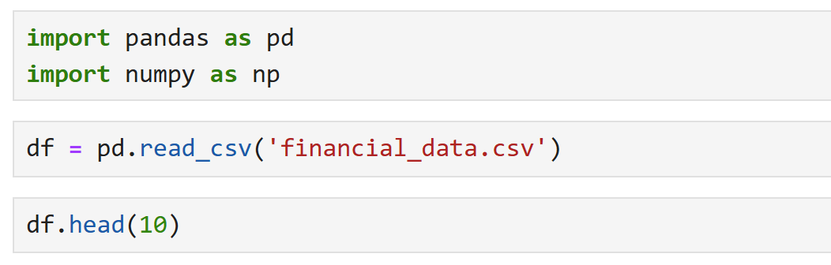
Data Gathering and Import
The data would be collected from the financial institution being serviced. Ideally the raw client data is organized into a table or database of sorts which includes columns for each financial parameter of the client.
For this solution implementation, the dataset was in a table format with 19 columns of client information including their risk rating

Slide 17
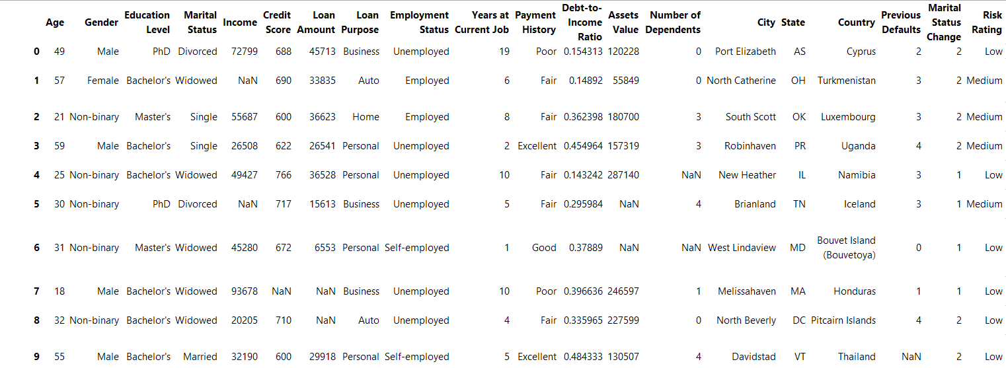
Sampled Raw Data

Slide 18
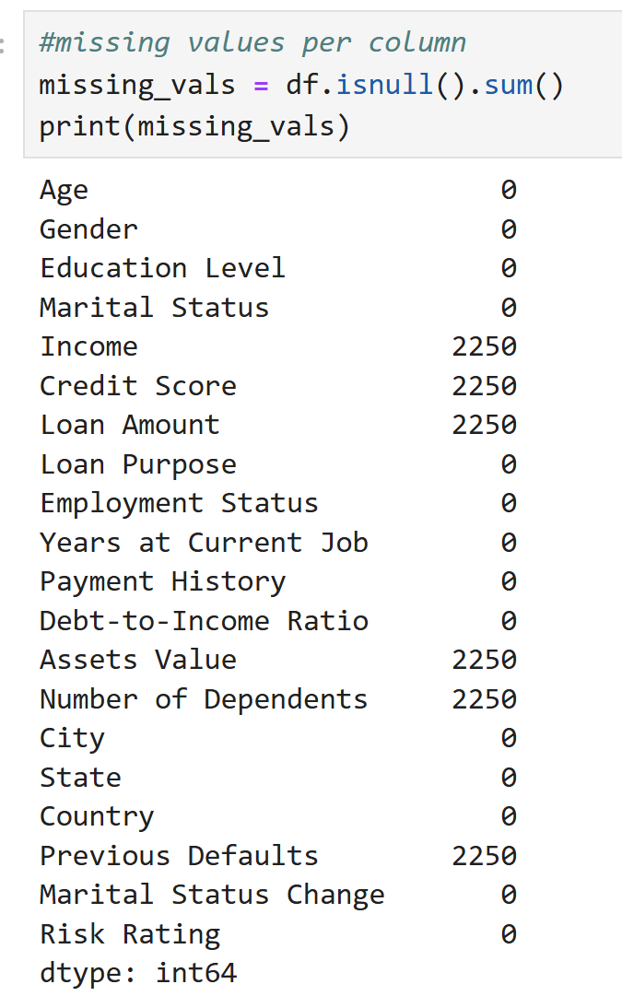
Data Clean up and Normalization
The data was cleaned up by removing parameters which are difficult to develop a correlation with. In the case of this solution and dataset, removing the columns pertaining to city and state made the solution run much faster. Since there are multiple hundreds of potential cities and many states, finding a correlation between data points may become difficult unless the dataset is massive and includes many datapoints from each individual city.
The data was normalized by filling in missing data points with median values from the whole dataset. The median value is used to prevent any changes to data averages while weighing each application consistently for the given information. For example, if payment history was an empty point, filling it in with poor could create a discrepancy in the overall correlation between risk profile and payment history from reality.

Slide 19
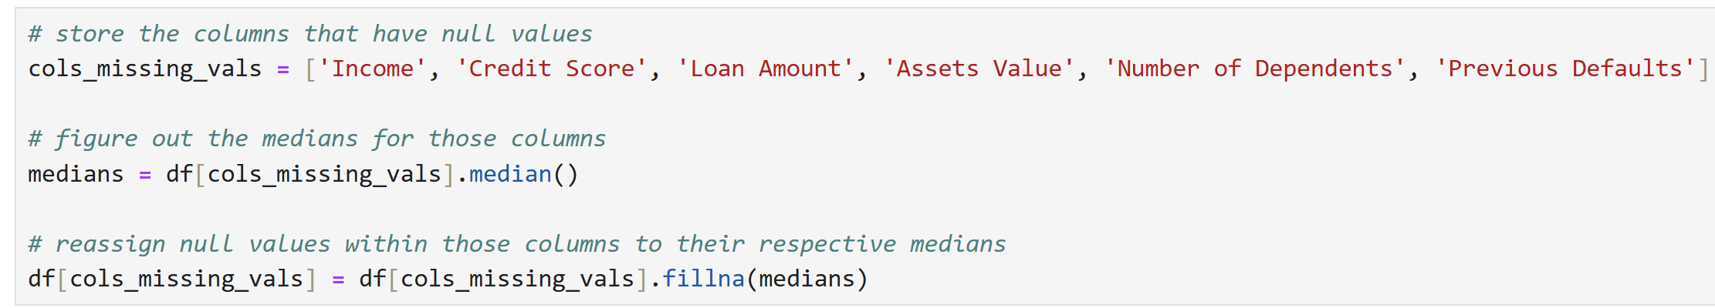
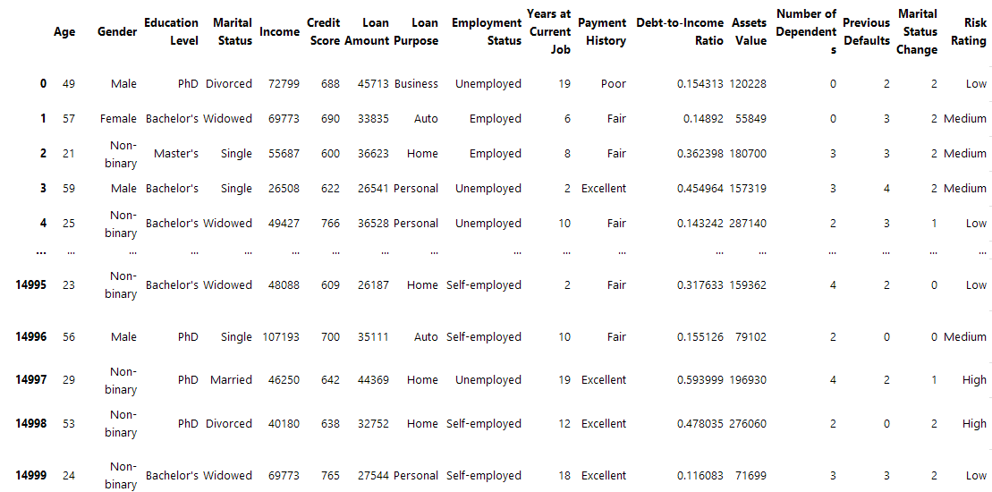
Sampled Cleaned and Normalized Data

Slide 20
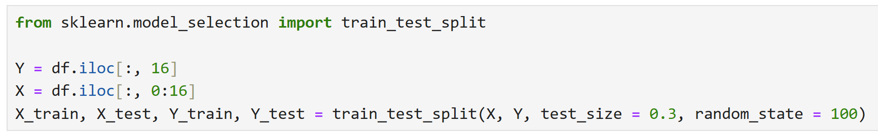
Machine Learning Setup
The machine learning algorithm is supervised as it is trained off of a known and labeled dataset with determined outcomes
Define a training and testing split of 30% test and 70% training
Imported all the relevant and required libraries to run the several different machine learning algorithms

Slide 21

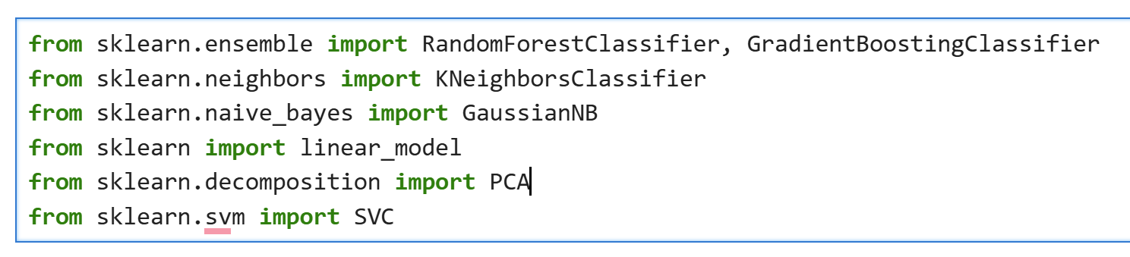
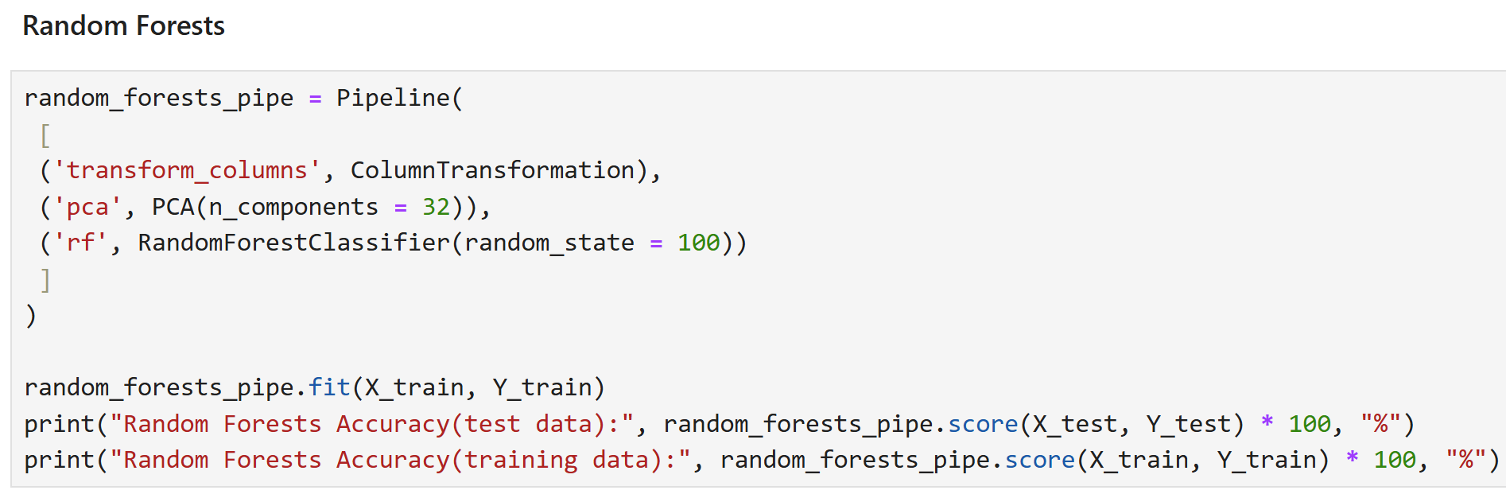
Machine Learning Algorithms
Random Forests
K-Nearest Neighbours
Gradient Boosting
Naïve Bayes
Logistic Regression
SVC

Slide 22

Deep Learning
To implement a deep learning algorithm, the dataset which the model is trained on would need to be very large. This likely limits the application of this solution to very large banks which hundreds of thousands of loan applications. Smaller firms would not have sufficient data to train a deep learning algorithm
Since the dataset is structured into specific categories a solution utilizing deep learning may not be needed to achieve a desirable outcome
Deep learning, utilizing a neural network, can be implemented for firms where there may not be consistent parameters across all applications.

Slide 23
Results and Recommendations
Commerce 3FN3 Big Data in Finance
G-15

Slide 24
Accuracy Results by Algorithm

Slide 25
Recommendations
Implement a machine learning algorithm to assist in loan application processing
Will allow for more flexible reaction time and capacity for the processing of new applications.
No longer need to rely on employee capacity for tasks which can be automated
The tested algorithms had relatively low scores across the board, however, this is most likely due to the limited range of data upon which it was trained. By utilizing larger datasets, accuracy will likely improve. Furthermore, adjustments can be made to the algorithms themselves to increase accuracy by adjusting specific parameters such as the number of PCA components.

Slide 26
Business Impacts
Employee Reduction
With the machine learning algorithm implemented, fewer man hours to process loan applications will be required
Faster Loan application turn around times
Algorithm can operate around the clock or be scaled easily as demand fluctuates, application backlog can be reduced or eliminated completely

Slide 27
Next Steps and Timeline
Establish the exact type of data set and parameters upon which the algorithm will be trained on and collect all data into raw dataset (months 1-3)
Determine optimal clean up and normalization script for the raw dataset (months 4-6)
Test all algorithms with varying parameters to identify which is most accurate (months 7-10)
Implement policies for future data collection and processing (months 11-13)
Create a front end to the algorithm for the employees who will be utilizing the tool (months 14-18)
Begin solution rollout and continually test and make changes as needed based on feedback (months 19-31)
Implement full solution and reduce staff as needed (ongoing)

Slide 28
Summary of Learnings
Developed a deeper understanding of how to implement machine learning to real life applications
Learned of the limitations of machine learning and the importance of large datasets to train the algorithms upon
Became more familiar with each different machine learning model and their parameters, developing an understanding of the importance of fine tuning algorithms based on their application

Slide 29
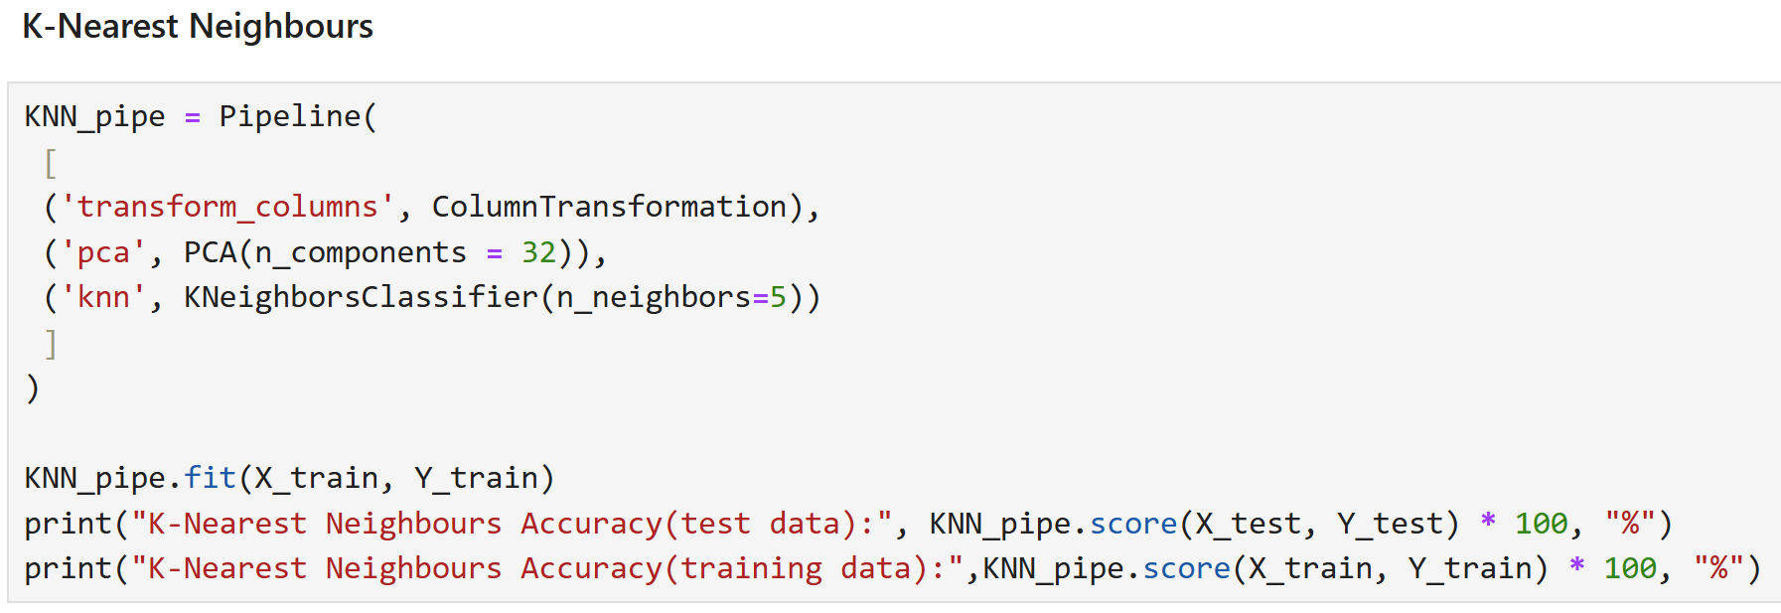
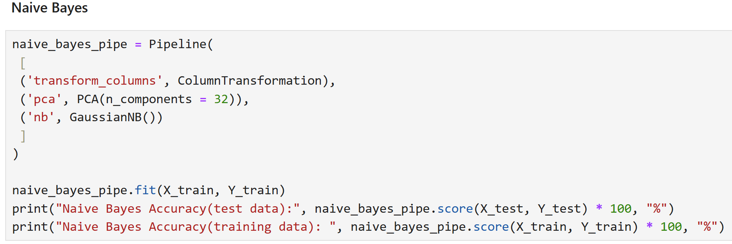
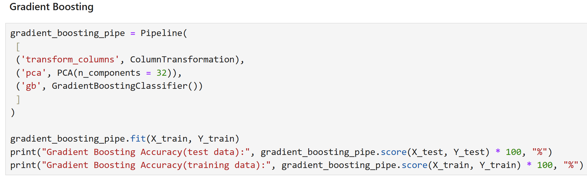
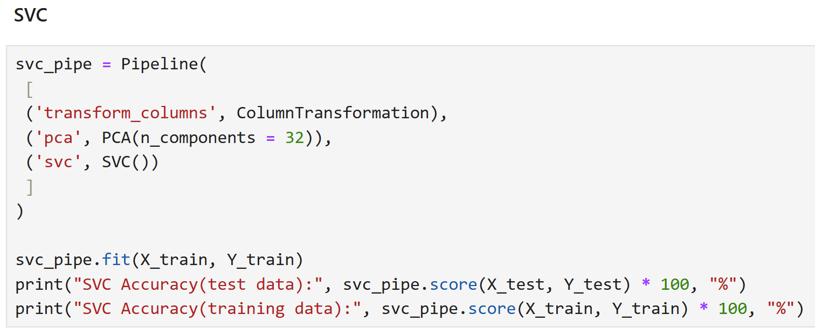
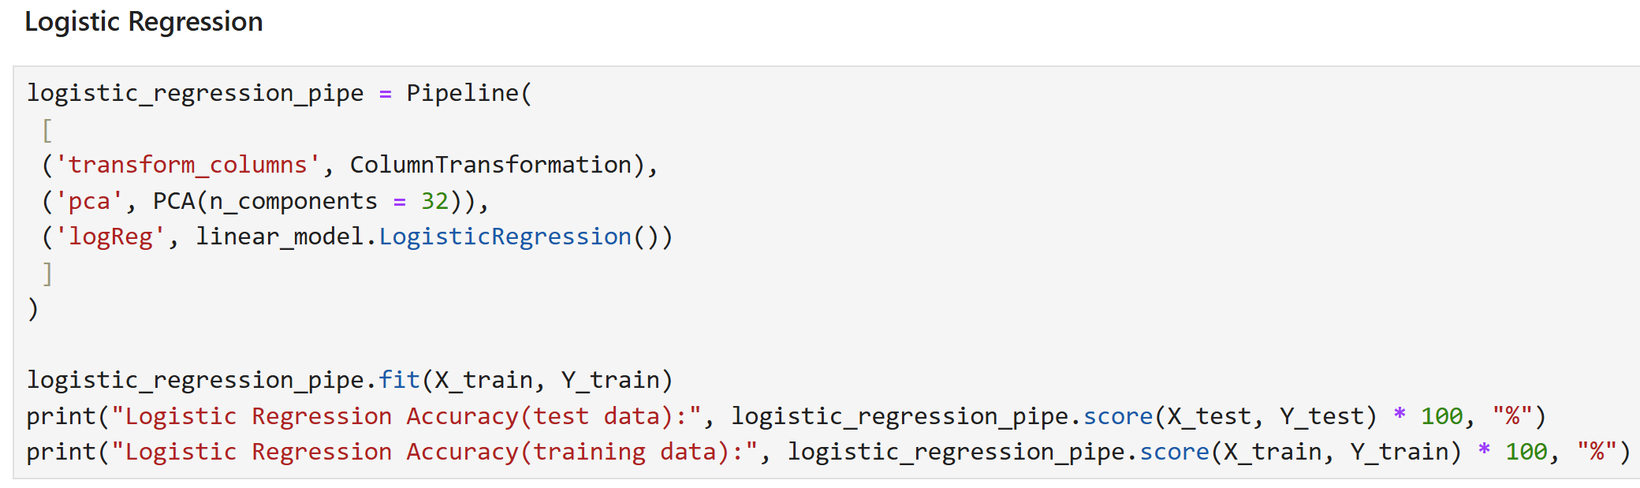
Appendix

